Slide 1
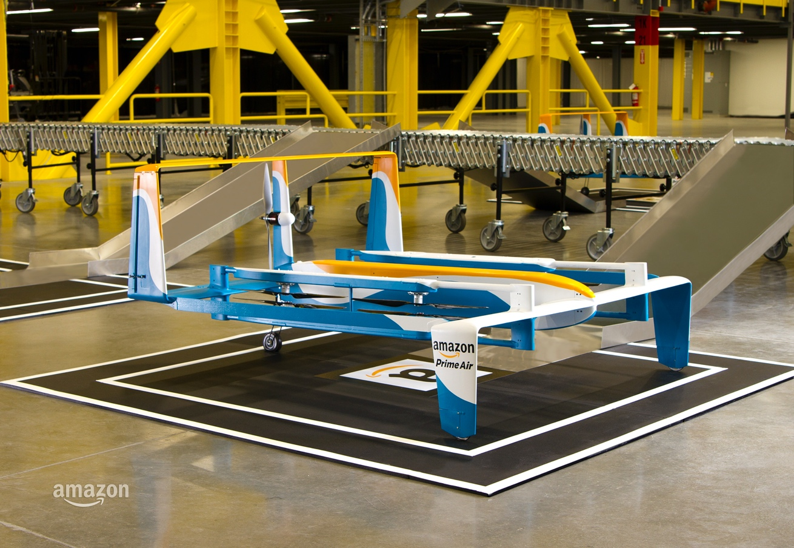
Team 3 Strategic Carrier Model Simulation (SCMS)
Notes:
Tyler

Slide 2
Agenda
Team SCMS
Background
Problem Statement
CONOPS and Systems Engineering Lifecycle
Assumptions, Constraints, and Requirements
Conceptual Model
Data Collection
Model Validation and Verification Plan
Simulation Demo
Results Validation
Experiments
Recommendations & Future Experiments
Notes:
Tyler

Slide 3
Team SCMS
Team Lead, Simulation: Tyler Hildebrandt
Notes:
Tyler

Slide 4
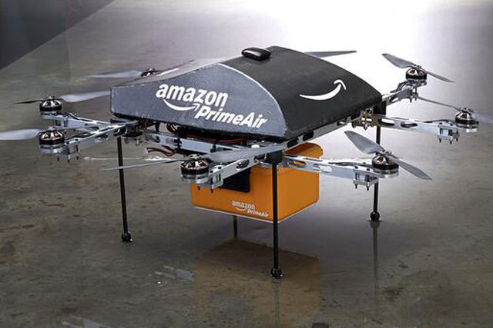
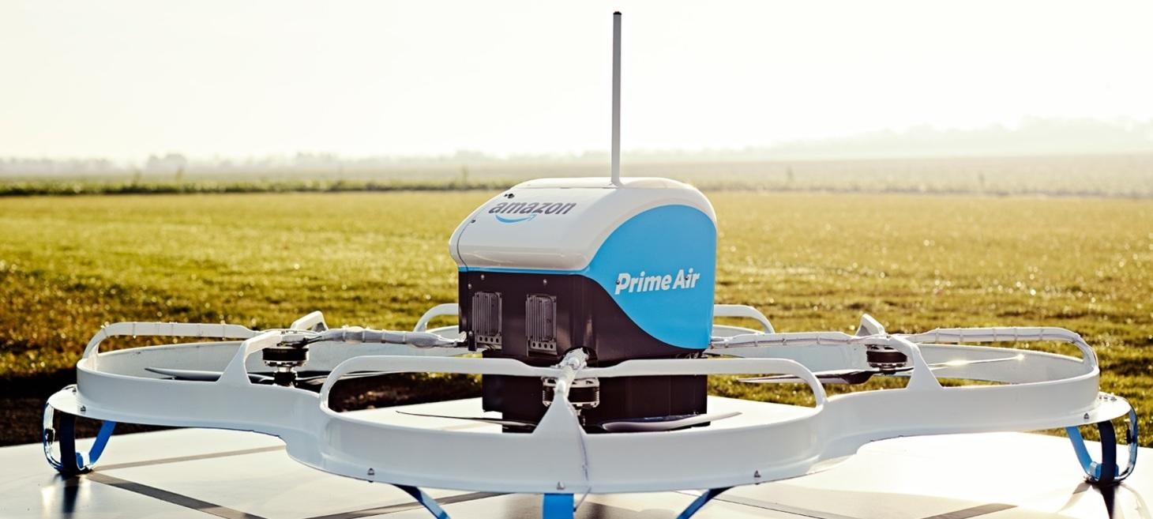
Background
Amazon has invested heavily in package delivery as part of its growth strategy
Amazon is the 4th largest package delivery service in the US
$39 Billion invested in development of delivery service since 2014
Shipping costs will reach an estimated $117 Billion by 2025
Further developments in shipping would be needed to meet the growing demand for products from Amazon
Seeking to use unmanned aircraft systems (UAS) as part of the development of their Prime Air service
Use of UAS to deliver packages within 30 minutes
Prime air would reduce cost from $1.20 per package to $0.36 per package
Notes:
CJ

Slide 5
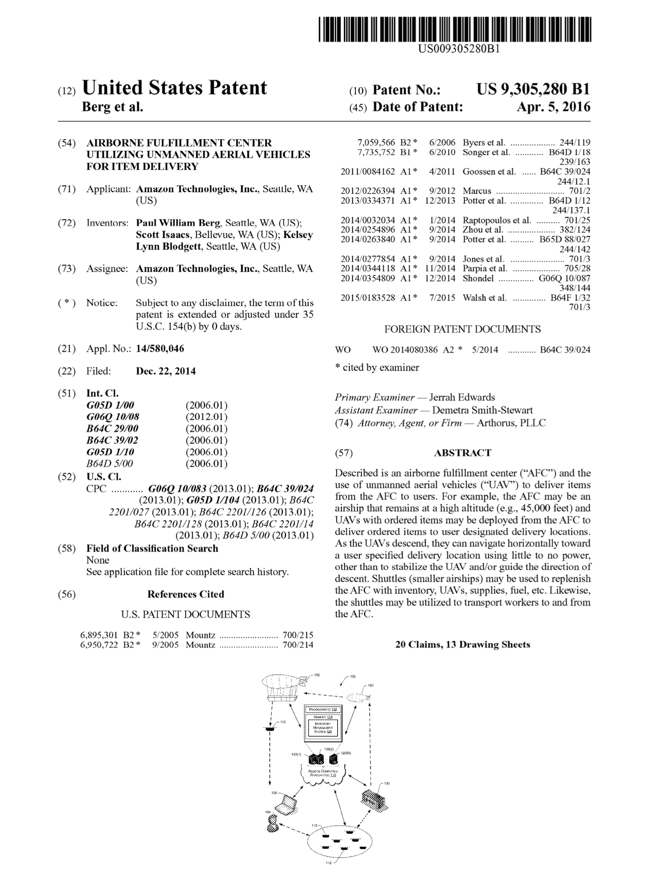
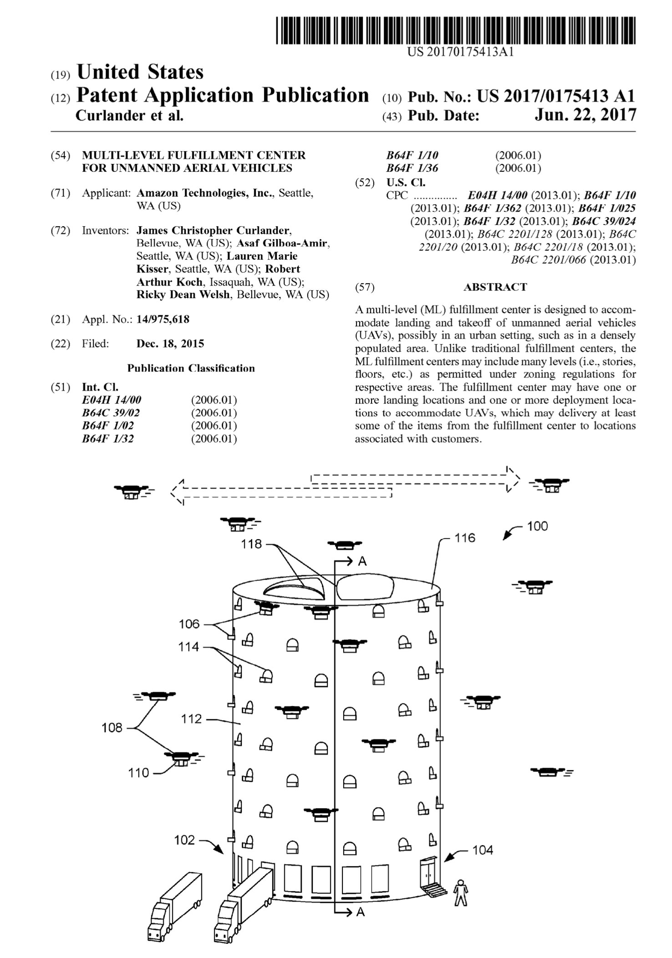
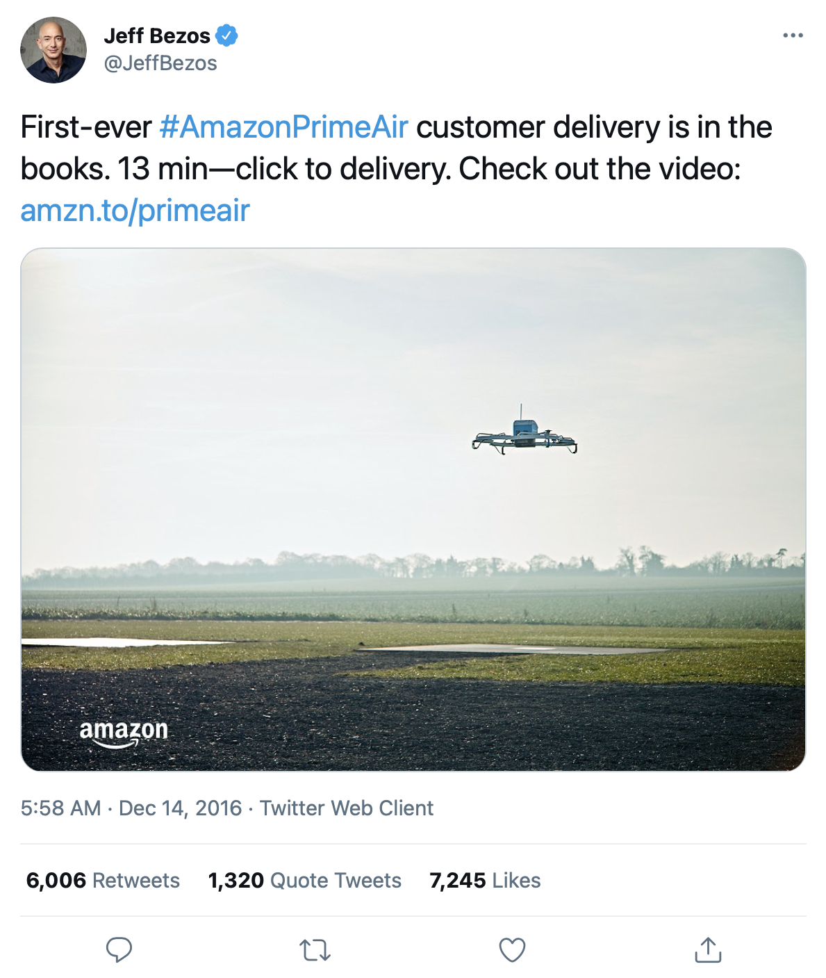
Future Delivery Solutions
Notes:
CJ

Slide 6
Problem Statement
Determine the minimum number of drones required to achieve a 95 % on-time delivery rate for a 30-minute delivery window within a 7.5 nautical mile radius of the Baltimore Amazon Fulfillment Center.
Notes:
CJ

Slide 7
CONOPS and Systems Engineering Lifecycle
Notes:
SM

Slide 8
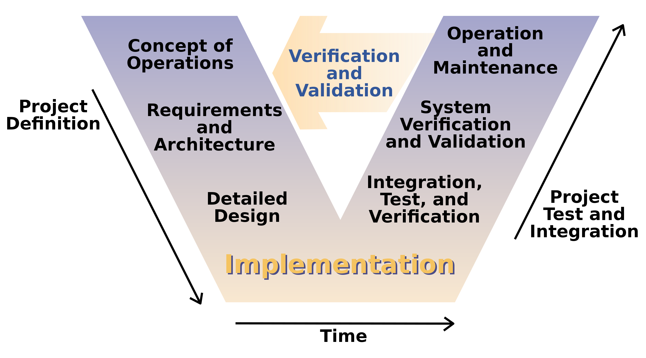
System Engineering Life Cycle
Notes:
SM

Slide 9
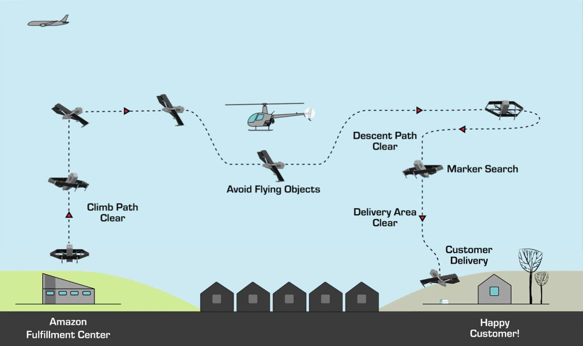
Prime Air CONOPS
Pre-Flight
Takeoff
Transition to Forward Flight
Navigate to Customer
Identify Drop Zone
Release Payload
Return
Notes:
SM
Pre-Flight
Pre-flight inspection
Preparing/loading the package for delivery
Ascend
An Operators in Command (OIC) will then be assigned to the UA
En Route
From the point of launch, flights will be conducted autonomously
Flight path will be planned to avoid any known obstacles, and active onboard sensors will provide separation assurance from any uncharted obstacles
Delivery
Once the UA arrives close to the delivery location, it will identify the specific delivery area through a unique marker and then perform a delivery area clear assessment using onboard sensors
If that condition is met, it will descend to a safe delivery height, hold in a hover position and, barring any other obstructions or hazards being sensed, release the package.
Once the delivery has been completed, the UA will return to the Amazon facility along a route that incorporates all operational limits and airspace constraints

Slide 10
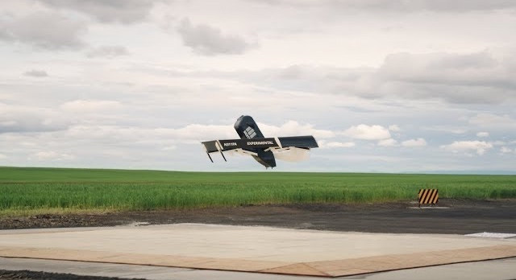



Qualification for Prime Air
Prime Air will deliver packages using UAS to customers within 30 minutes of placing their order.
Before a customer can place an order for delivery via Prime Air:
Reviewed weather conditions to ensure the UA will remain within operational limits
Icing: No flights in known icing conditions
Wind: Max 24 knots (total including gusts)
Areas of significant meteorological activity: No operations
Identified all known airspace constraints
High level of confidence that the potential order can meet the 30-minute delivery commitment
Payload fits within the weight and space constraints of the MK27
Notes:
SM

Slide 11
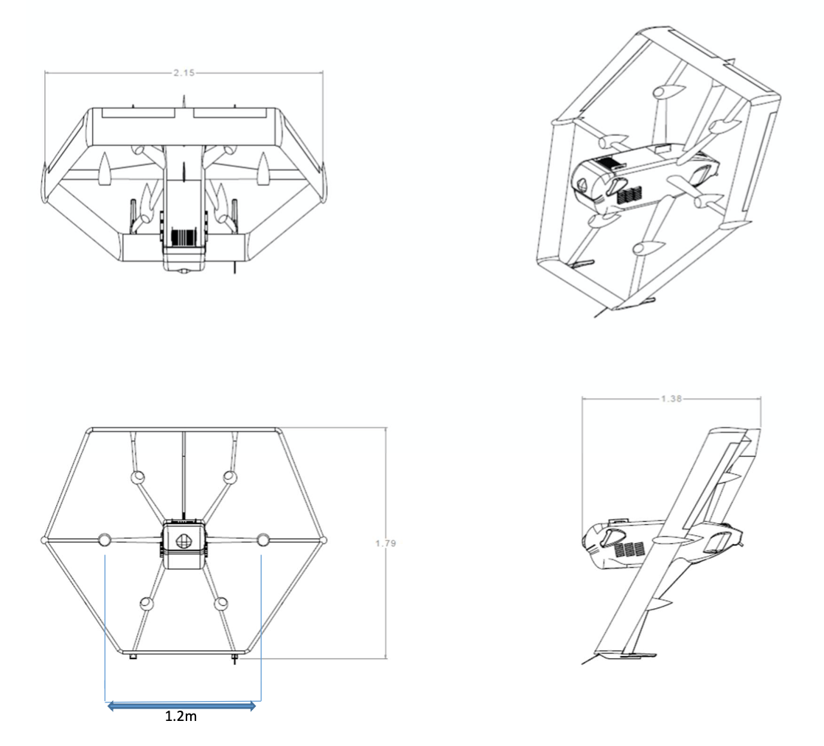
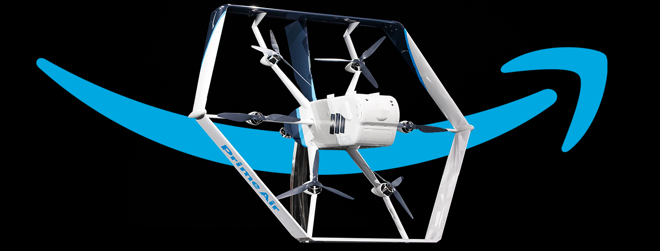
Data: Drone MK27 UAS
General Specifications & Performance Characteristics
UA Type | VTOL hybrid
Max payload weight at planned range | 5 lbs.
Nominal cruise speed | 60 kts. IAS
Max planned operating altitude | 400 ft. AGL
Max operating altitude | 1,200 ft AGL
Planned Range | 15 NM. Round trip (with reserve)
Notes:
SM

Slide 12
Service Area
Simulation will focus on Baltimore metropolitan area with orders being fulfilled at the BWI2 Amazon Fulfilment Center
Service Area is 7.5 NM radius
Area includes:
Baltimore city
Baltimore County
Anne Arundel County
BWI2: Amazon Fulfillment Center
Baltimore, MD
Notes:
SM

Slide 13
Assumptions, Constraints, and Requirements
Notes:
CK

Slide 14
Model Assumptions and Simplifications
Assumptions
Drone modeled to perform under nominal operating characteristics
Environmental conditions do not impact drone's performance
Payload weight will not impact drone performance
Receiving and preparing orders will be done in parallel to drone operations
Drone delivery is FAA approved
Simplifications
Drone will perform one delivery per round trip
Battery pack will be swapped during pre-flight time if capacity is insufficient for delivery distance
Orders will be delivered to the centroid of each census tract
Notes:
CK

Slide 15
Simulation Requirements
Requirement ID | Requirement | Baseline | Input | Output
SCMS-001 | Generate the optimal number of drones needed to satisfy a 7.5 nautical mile service area around the Baltimore Amazon fulfillment center. | X |  | X
SCMS-002 | The simulation shall consider various drone fleet sizes. | X | X
SCMS-003 | The simulation shall provide delivery times from order confirmation to package delivery as an output. | X |  | X
SCMS-004 | The simulation shall accept various order rates as an input. | X | X
SCMS-005 | The simulation shall accept location coordinates as inputs for delivery sites. | X | X
SCMS-006 | The simulation shall consider population density when generating orders. |  | X
SCMS-007 | The simulation shall include a 2-D graphical representation of the service area. | X
SCMS-008 | The simulation shall generate representative orders based on the service population. | X | X
SCMS-009 | The simulation shall consider various adoption rates for drone delivery. | X | X
SCMS-010 | The simulation shall follow the Amazon CONOPs for drone flight. | X
Notes:
CK

Slide 16
Conceptual Model
Notes:
Alex

Slide 17



Conceptual Model
Assumed Values
Input Data
Service Area
Pre-Flight Time
Battery Swap Time
Key Variables
Population Density
Drone Speed
Delivery Location
Data
Interpretation
SCMS
Simulation
Optimized Fleet Size
Order Rate
Raw Data Output
Optimize Data
Fleet Size
Target Delivery Time
V&V and Update Parameters
Notes:
Alex

Slide 18
Notes:
Alex

Slide 19
Notes:
Alex

Slide 20
Order Distribution
Prime Air plans to offers 30-minute delivery 24 hours a day
For the simulation, it is assumed all orders are made between 8:00am – 8:00pm
Number of orders made outside of this window are negligible
Order rates will also fluctuate during the day and is assumed to fall into a normal distribution with peak ordering times between 1:00pm – 3:00pm
Notes:
Alex

Slide 21
Data Collection
Notes:
Tyler

Slide 22


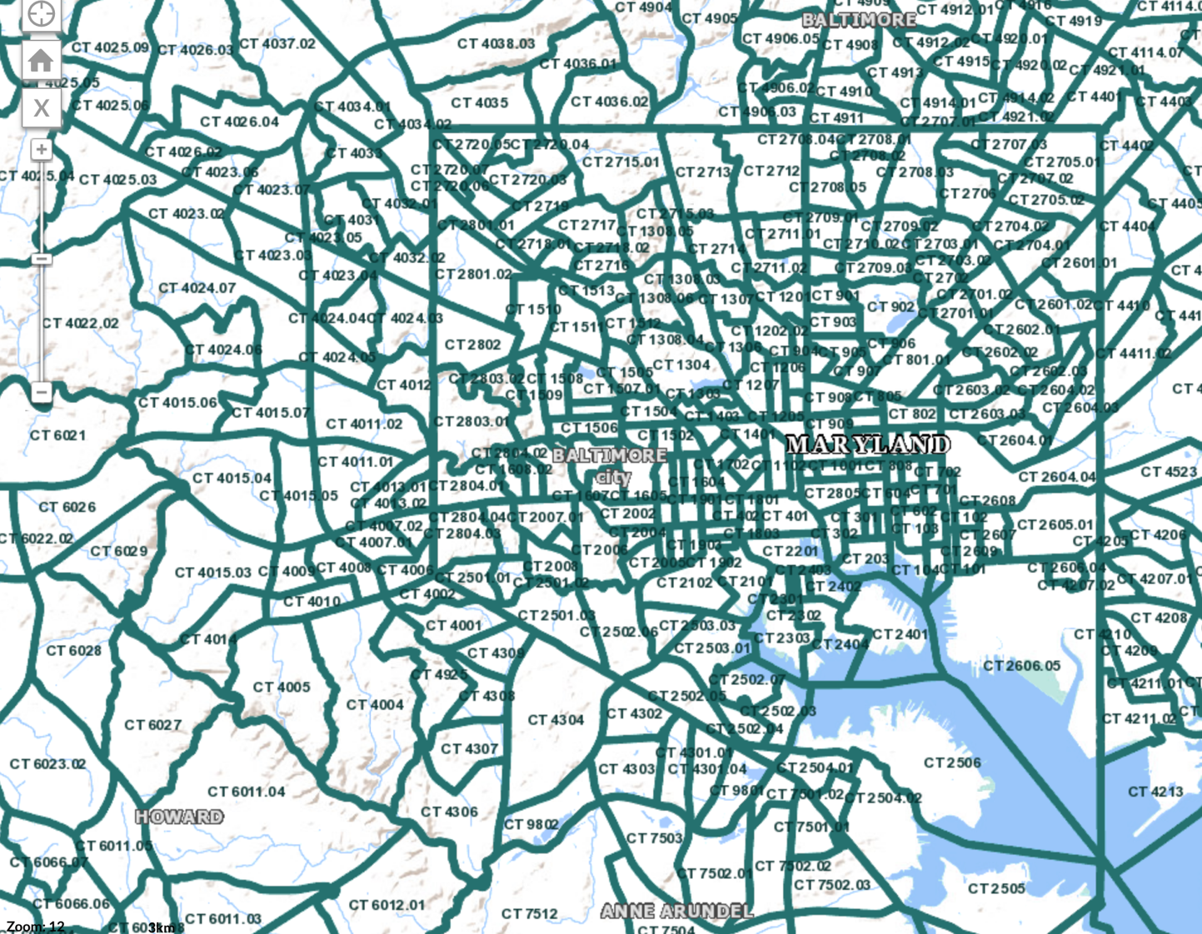
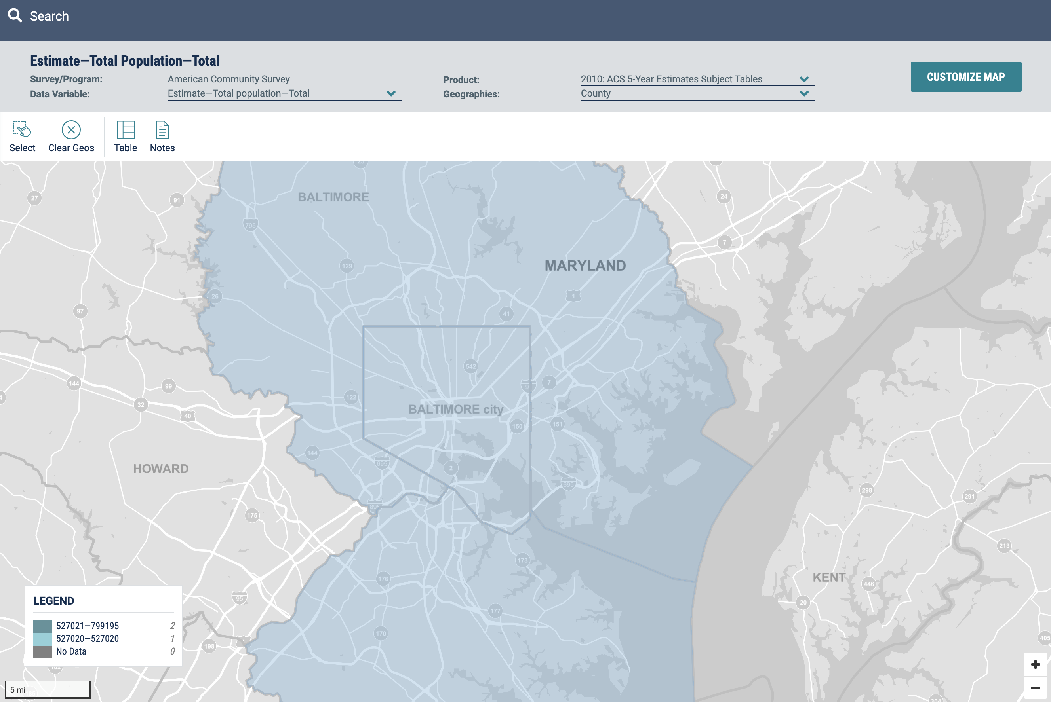
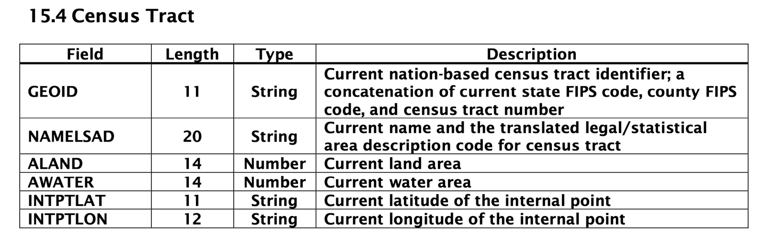
Data: Population and Location
Tract Location
Tract Population
tigerweb.geo.census.gov
data.census.gov
+
Notes:
Tyler

Slide 23
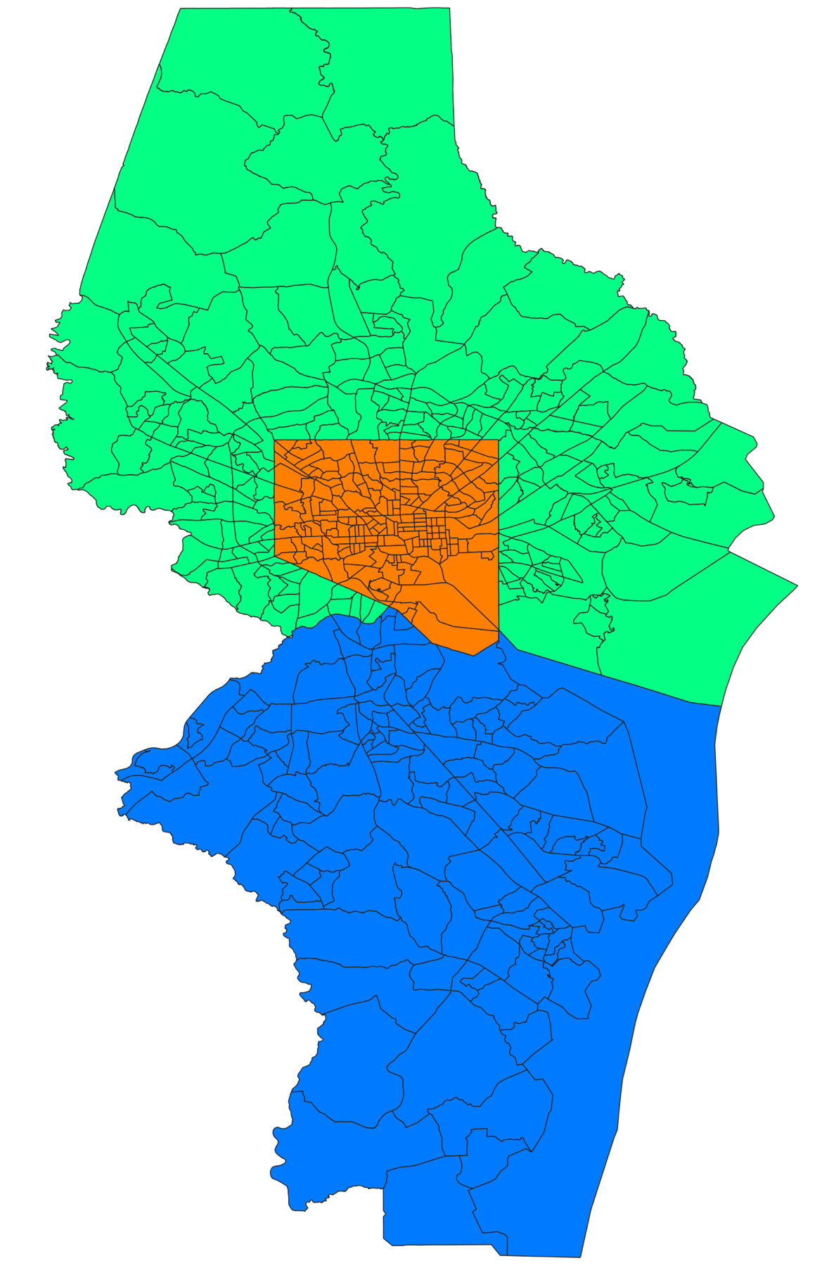
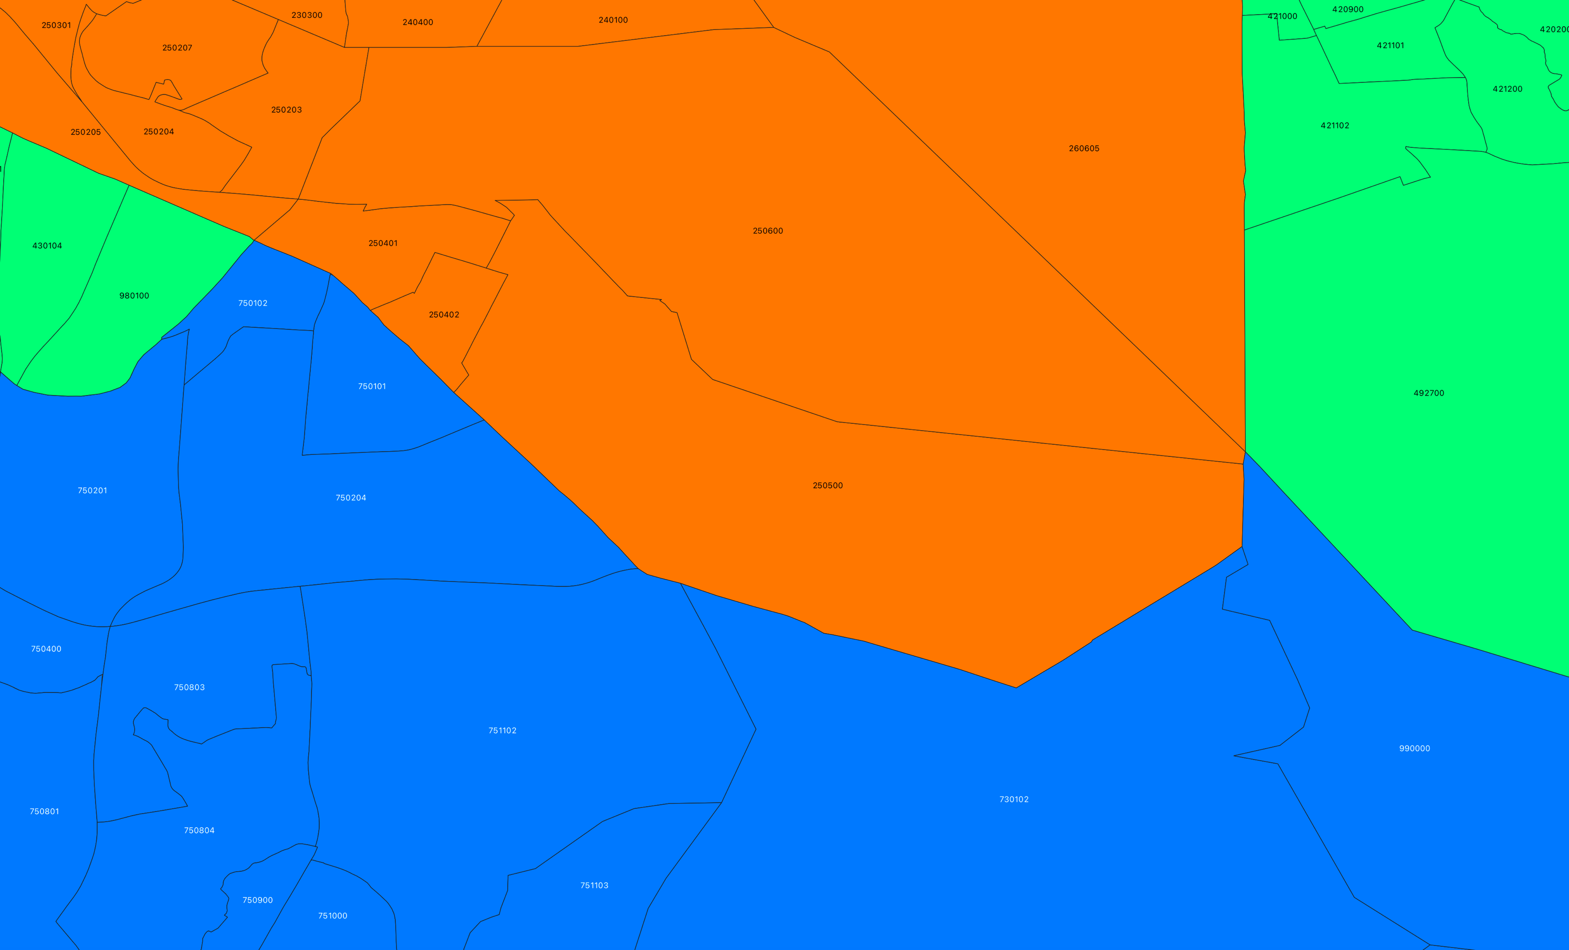
FIPS Codes and Tracts
24005
Baltimore County
24510
Baltimore city
24003
Anne Arundel County
Notes:
Tyler
Federal Information Processing System (FIPS) Codes. FIPS codes are numbers which uniquely identify geographic areas.
County-level FIPS codes have five digits of which the first two are the FIPS code of the state to which the county belongs.
24005 Baltimore County
24003 Anne Arundel County
24510 Baltimore city

Slide 24
Model Validation and Verification Plan
Notes:
CJ

Slide 25
Model Validation and Verification Plan
Validation
Review problem statement & requirements
Understand application and requirements
Translate conceptual model to code
Review conceptual model & identify gaps
Verification
Compare to existing models & identify risk
Verify code consistent behavior
Assess code correctness
Modify conceptual model to accommodate real world results
Solution validation
Compare to real world data
Notes:
CJ

Slide 26
Model Validation
SCMS Simulation
Orders:
Orders generated through weighted probability based on population
Delivery location based on census tract data
Daily orders extrapolated from national average
Drone flight:
Developed from known MK27 performance parameters
State diagram follows Amazon CONOPs
Loading times using time uniform distributions
SCMS
Simulation
Notes:
CJ

Slide 27
Assumptions: Orders
Order Information | Notes
Order Rate | Calculated from known 2019 package delivery and US population data
 | Service area population data used
 | Packages of 5 lbs. or less are considered 85% of total orders
Order Time | Normal distribution over 8 AM – 8 PM
Order Probability | Orders generated based on population density
 | Orders contain location information from census data
Notes:
CJ

Slide 28
Assumptions: Phase Durations
Phase | Min | Max | Mean | Notes
Retrieve and prepare package, swap battery (if needed) | 5 | 10 | 7.5 | Uniform
Load and ascend | 2 | 3 | 2.5 | Uniform
Horizontal flight (to customer) | ~0 | 7.5 | 3.75 | 3.75 nm / 60 knots = 3.75 minutes
Descend and deliver | 3 | 4 | 3.5 | Uniform
Ascend from customer | 1 | 2 | 1.5 | Uniform
Horizontal flight (return) | ~0 | 7.5 | 3.75 | 3.75 nm / 60 knots = 3.75 minutes
Descend and land (return) | 1 | 2 | 1.5 | Uniform
Total delivery | 10 | 24.5 | 17.25
Total round trip | 12 | 36 | 23.75
Notes:
CJ

Slide 29
Requirement Validation
Notes:
CJ

Slide 30
Model Verification
Generated more customer agents to prevent queue back-up
Transformed order rate to be understood by AnyLogic
Created customer state-diagram to model order rate change over time
Verify code consistent behavior
Assess code correctness
Run overload scenarios
Notes:
CJ

Slide 31
Simulation Demo
View and Run Model on AnyLogic Cloud
Notes:
Tyler

Slide 32
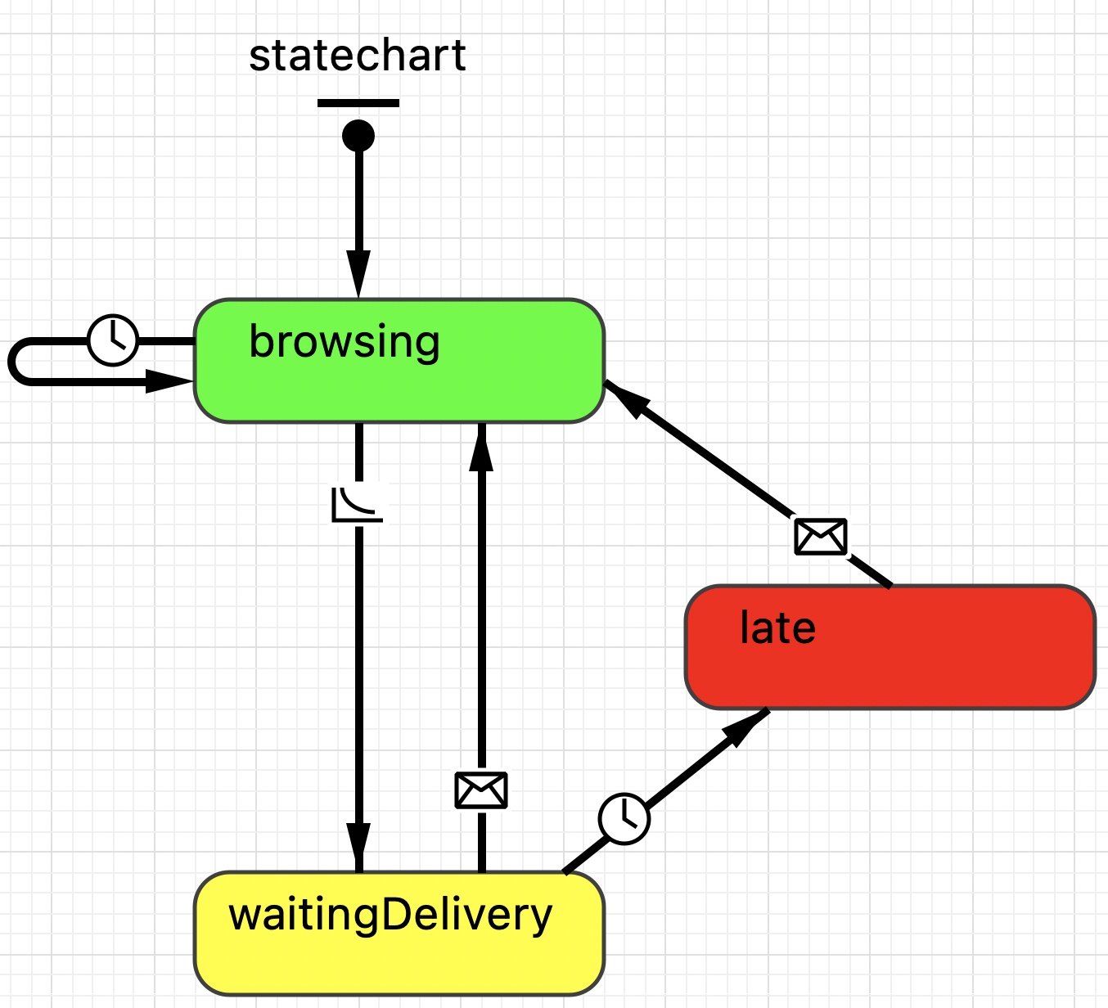
Customer Order Logic
Notes:
Tyler

Slide 33
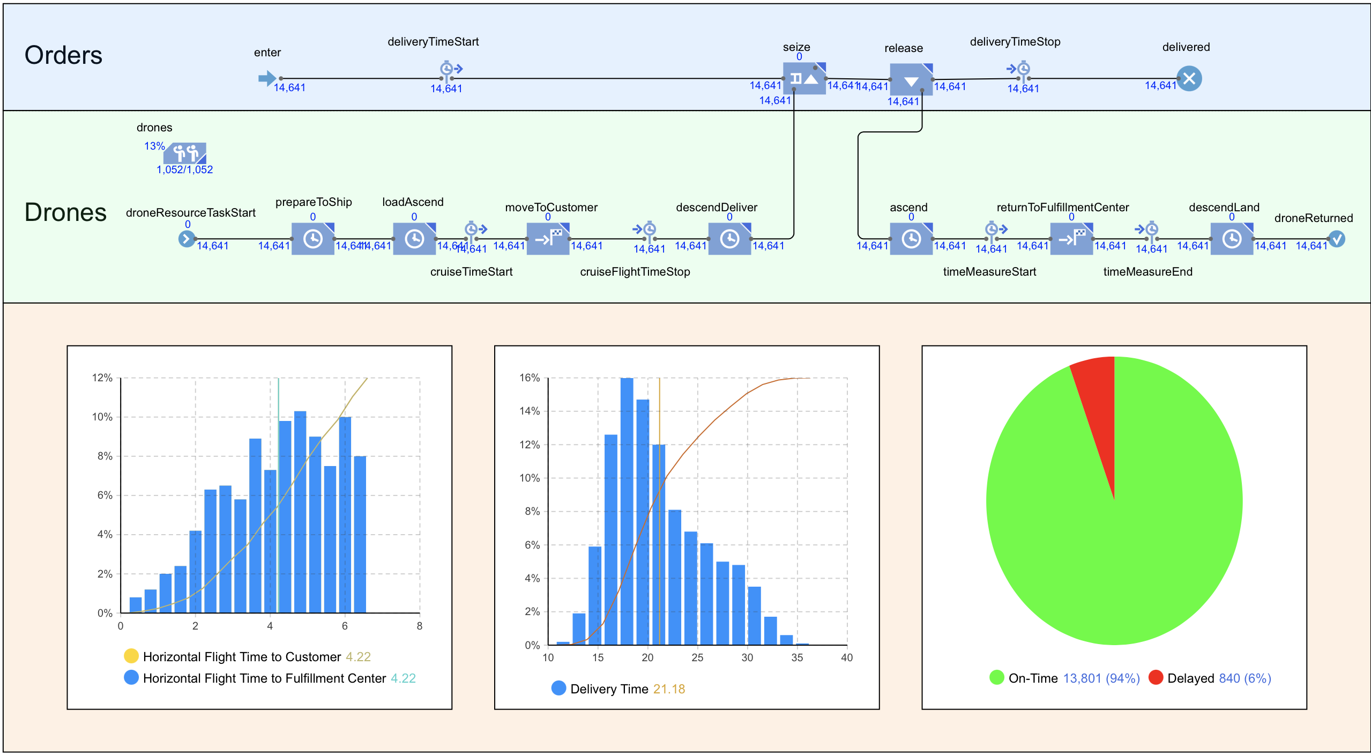
Notes:
Tyler

Slide 34
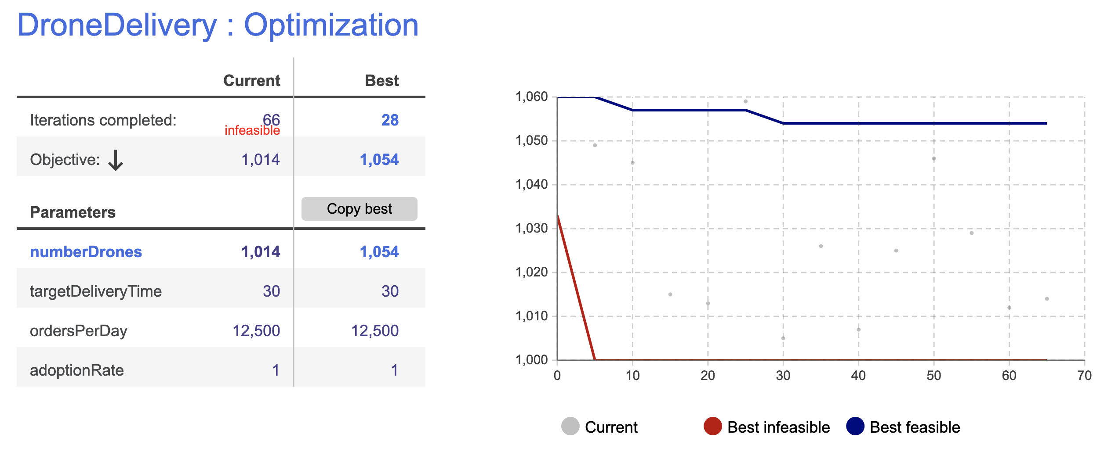
Optimization
Notes:
Tyler

Slide 35
Result Validation
Notes:
Tyler

Slide 36
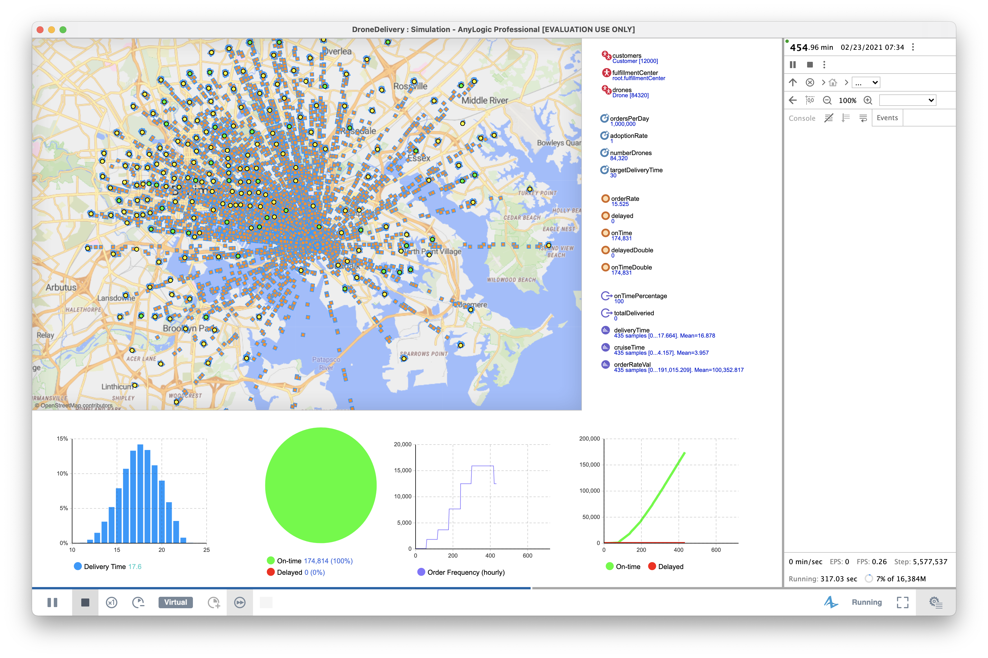

Slide 37
Experiments
Notes:
CJ

Slide 38
Experiment 1 – Vary Adoption Rate
Adoption Rate | Drones
1 | 1054
.9 | 962
.8 | 859
.7 | 763
.6 | 664
.5 | 561
.4 | 452
.3 | 346
.2 | 229
.1 | 116
Notes:
CJ

Slide 39
Experiment 2 – Vary On-time Percentage
On-time | Drones | Fleet size %
100% | 1108 | 100%
95% | 1054 | 95%
90% | 1038 | 94%
85% | 1024 | 92%
80% | 1016 | 92%
75% | 995 | 90%
70% | 980 | 88%
65% | 963 | 87%
60% | 955 | 86%
55% | 955 | 86%
50% | 955 | 86%
10% | 955 | 86%
Notes:
CJ

Slide 40
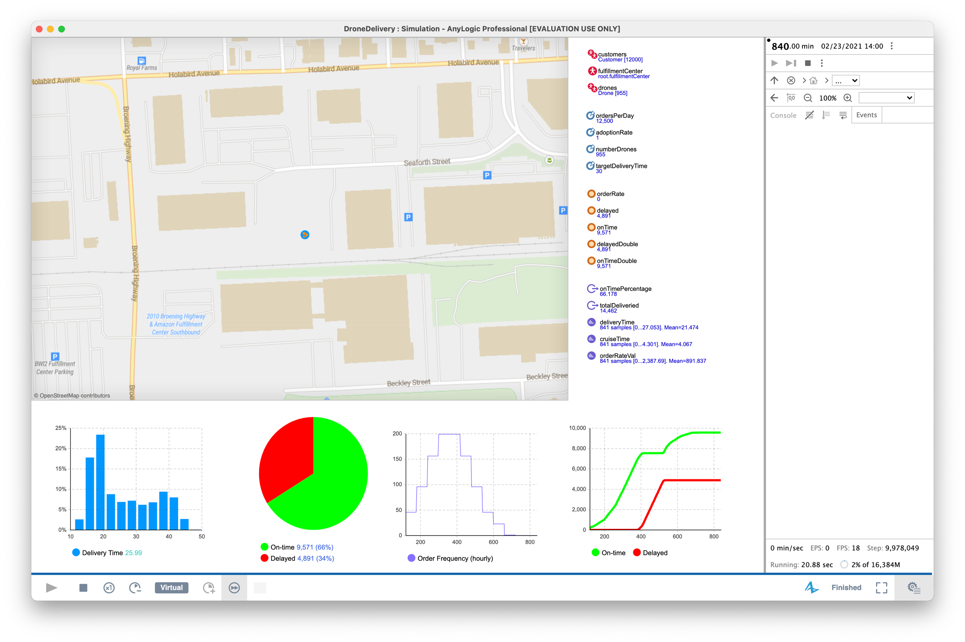
Experiment 2 – Vary On-time Percentage

Slide 41
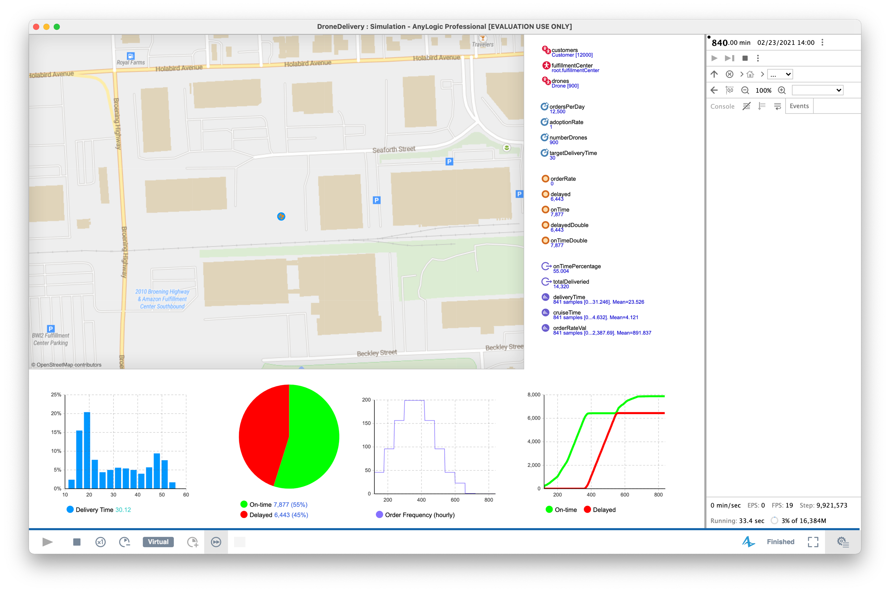
Experiment 2 – Vary On-time Percentage

Slide 42
Recommendations & Future Experiments
Notes:
CJ

Slide 43
Recommendations
More focus should be paid on adoption rate as opposed to on-time statistics
Drone fleet sizes should consider peak order rate for sizing
Model results should be validated to real world data on drone flight time, order preparation, etc.
Small scale experiment should be done to generate representative data for comparison to simulated results
Notes:
CJ

Slide 44
Future Experiments
Rerun using random seed
Vary delivery phase delay time ranges and distribution types
Import real world customer data with order rates tied to customer addresses
Integrate cost data for drones and orders to make financial decisions
Notes:
CJ

Slide 45
Questions?

Slide 46
Backup Slides

Slide 47
Sample Order Probability Table
tract | lat | lon | distance_nm | pop | weight | start | stop
420800 | 39.26777 | -76.515002 | 1.340679516 | 1706 | 2 | 1 | 2
420900 | 39.26267 | -76.521902 | 1.081688222 | 2796 | 2 | 3 | 4
421000 | 39.26085 | -76.527413 | 0.909596662 | 2039 | 1 | 5 | 5
421101 | 39.25511 | -76.516209 | 1.624150465 | 2599 | 2 | 6 | 7
420500 | 39.28617 | -76.523094 | 1.448414093 | 6176 | 4 | 8 | 11
420600 | 39.28644 | -76.514767 | 1.772605945 | 1136 | 1 | 12 | 12
420701 | 39.27718 | -76.513835 | 1.487187566 | 3588 | 2 | 13 | 14
420702 | 39.27593 | -76.525412 | 0.885457812 | 3806 | 3 | 15 | 17
420302 | 39.26994 | -76.486393 | 2.86579709 | 2470 | 2 | 18 | 19
id | random | tract | lat | lon | distance_nm | pop
1 | 72 | 450504 | 39.3027212 | -76.445445 | 5.54801078 | 5526
2 | 324 | 130100 | 39.3152603 | -76.634224 | 5.95101542 | 2919
3 | 234 | 80600 | 39.3104188 | -76.593478 | 4.01765972 | 2456
4 | 330 | 130400 | 39.3225962 | -76.644872 | 6.70427863 | 1983
5 | 88 | 440900 | 39.3421732 | -76.501243 | 5.42017709 | 3428
6 | 205 | 10100 | 39.2786343 | -76.574579 | 1.95613498 | 3028
7 | 1 | 420800 | 39.267765 | -76.515002 | 1.34067952 | 3298
8 | 572 | 270600 | 39.3583436 | -76.566028 | 6.28588749 | 4724
9 | 648 | 271001 | 39.3430254 | -76.605059 | 6.15282586 | 2483
10 | 248 | 70100 | 39.2998323 | -76.57543 | 2.81915161 | 2645

